Slide 1
TASK 1 -Pauline Hannah K
In the below slides, I have given the screenshots of the five labs I completed in Portswigger website. It challenging and gave a clearer idea about Cross-site Scripting

Slide 2
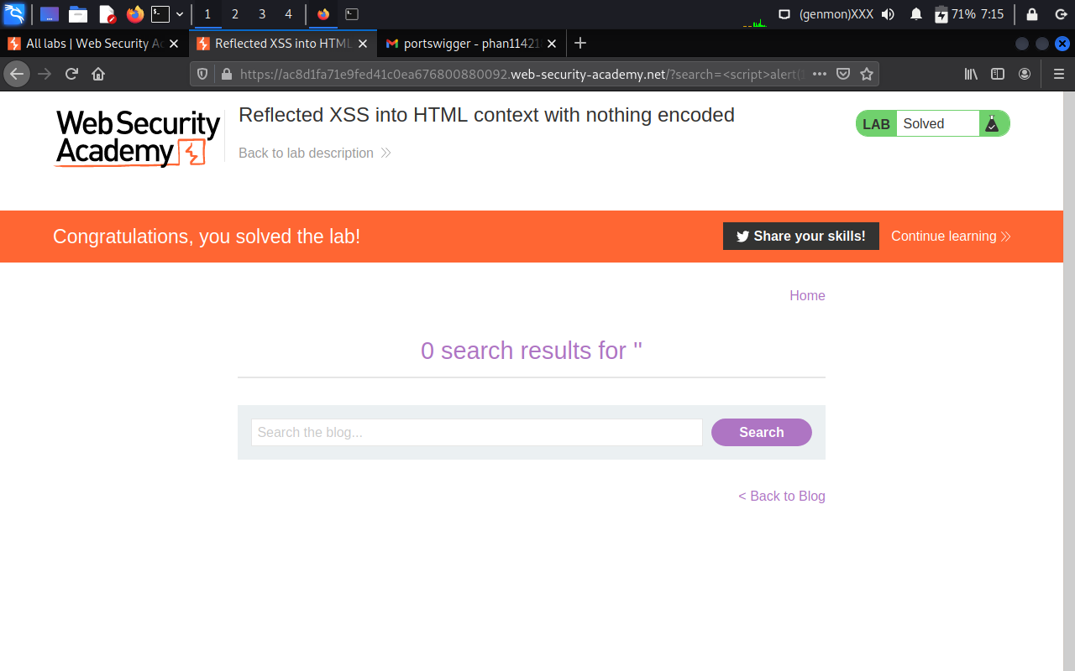
Reflected XSS into HTML context nothing encoded

Slide 3
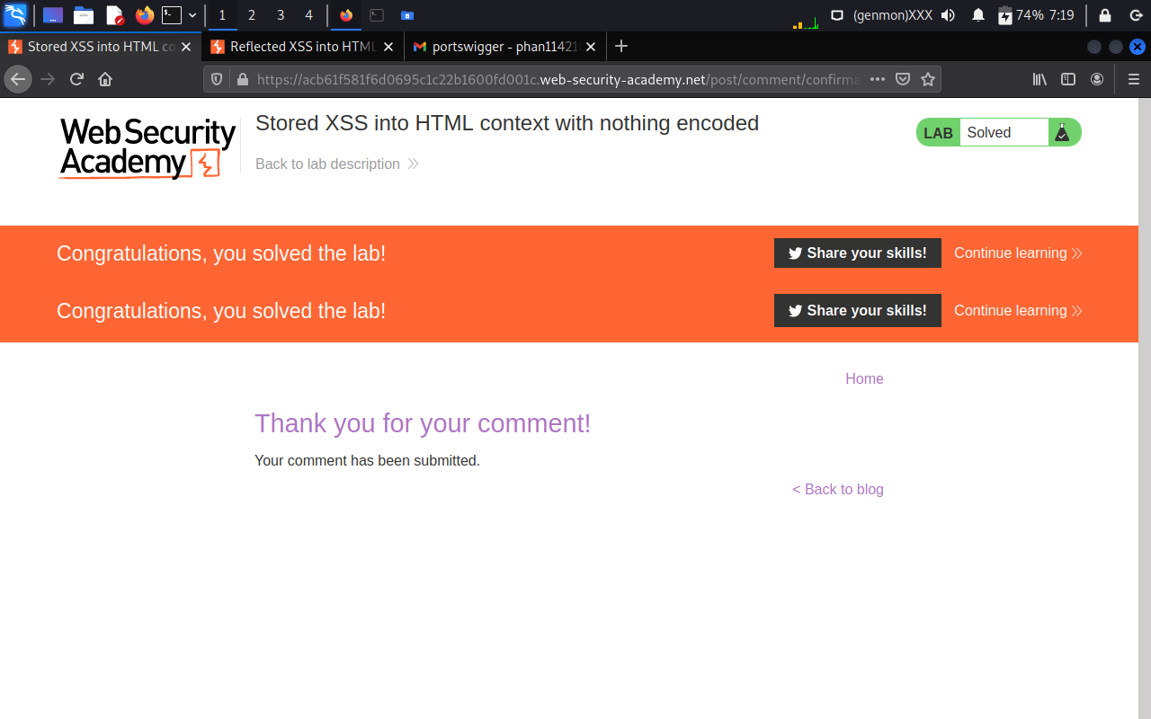
Stored XSS into HTML context with nothing encoded.

Slide 4
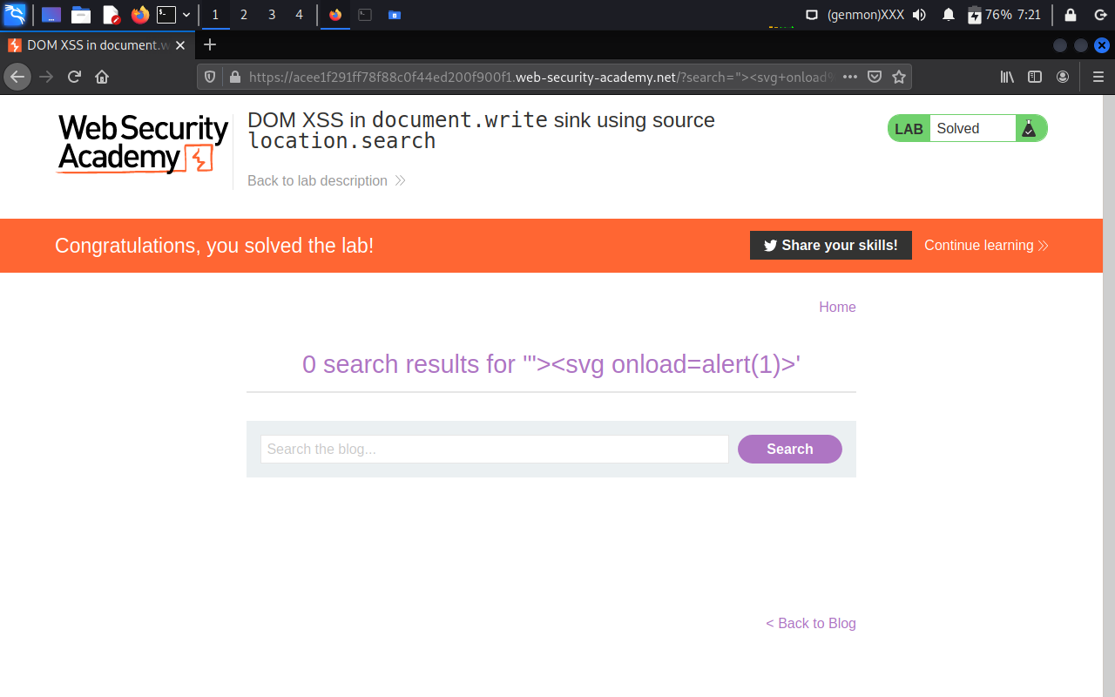
DOM XSS in document.write sink

Slide 5
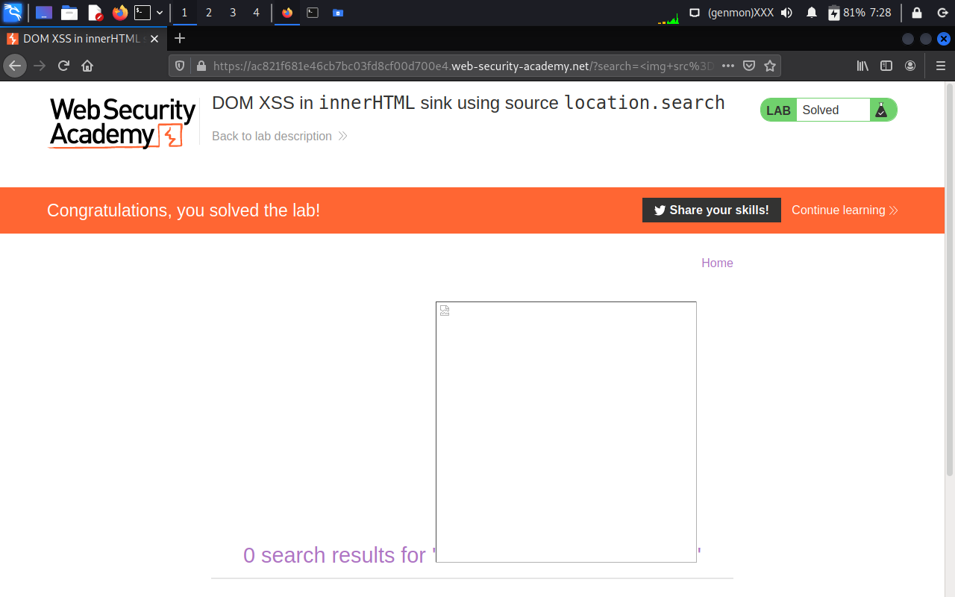
DOM XSS in InnerHTML sink

Slide 6
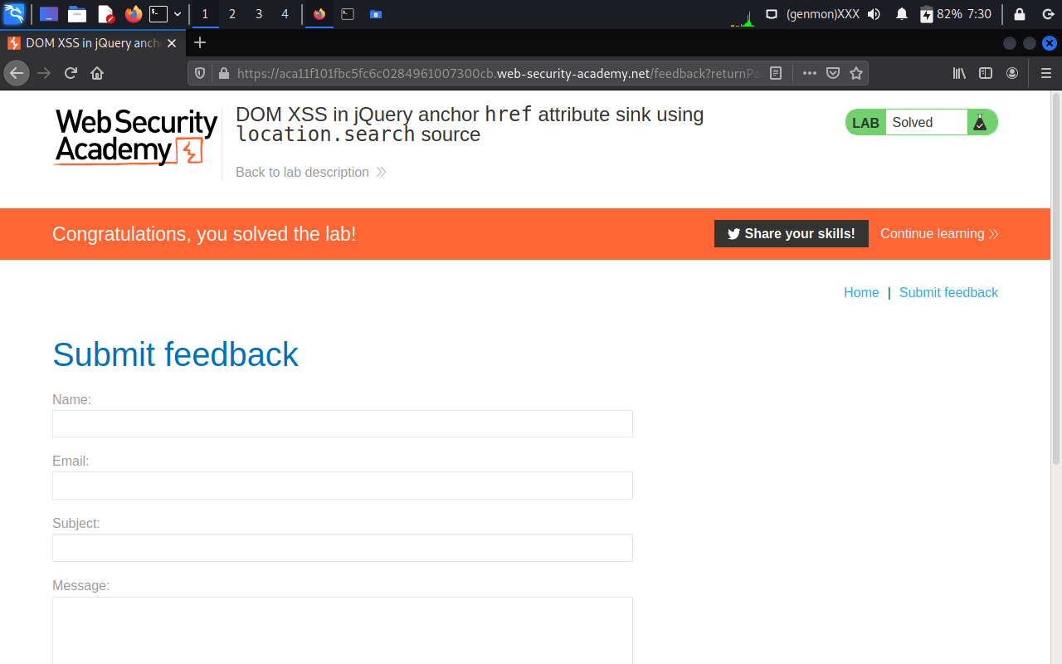
DOM XSS using location.search source

Slide 7
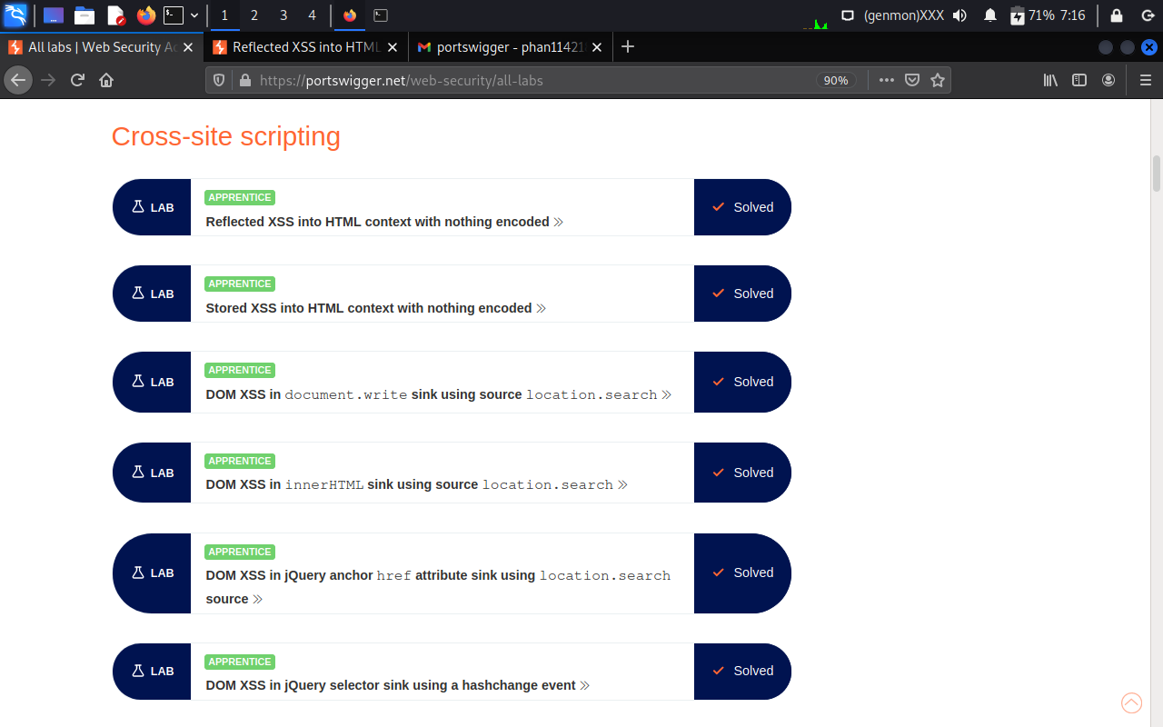
TASK 1
5 XSS LABS SOLVED IN PORTSWIGGER

